Slide 1
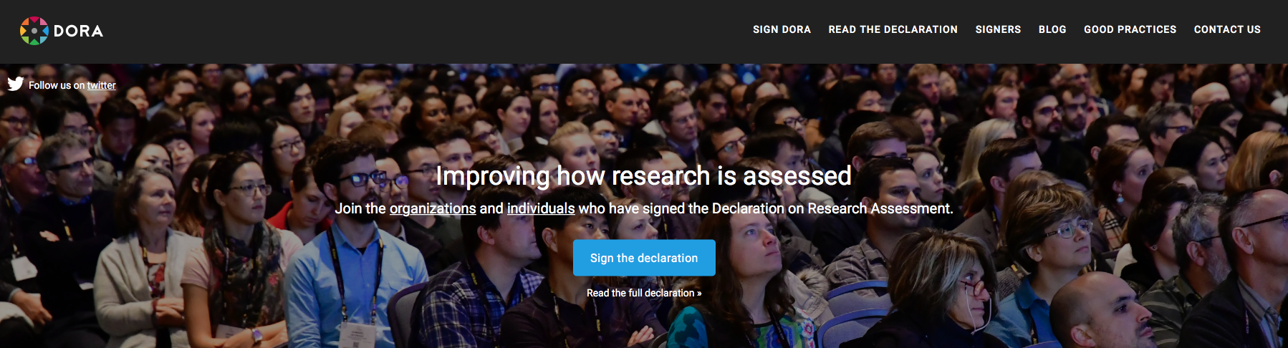
Driving Institutional Change for Research Assessment Reform
Stephen Curry
DORA & Imperial College
HHMI-DORA meeting | 21-23 October 2019

Slide 2

DORA: a declaration and a campaign
          San Francisco Declaration on Research Assessment (sfdora.org)
          >15,000 individuals & >1500 organisations have signed
          International steering group; global advisory board
          Roadmap for action:
            Increase awareness of the need to develop alternatives to the JIF
            Research and promote best practice in research assessment
            Extend the global and disciplinary impact of DORA

Slide 3
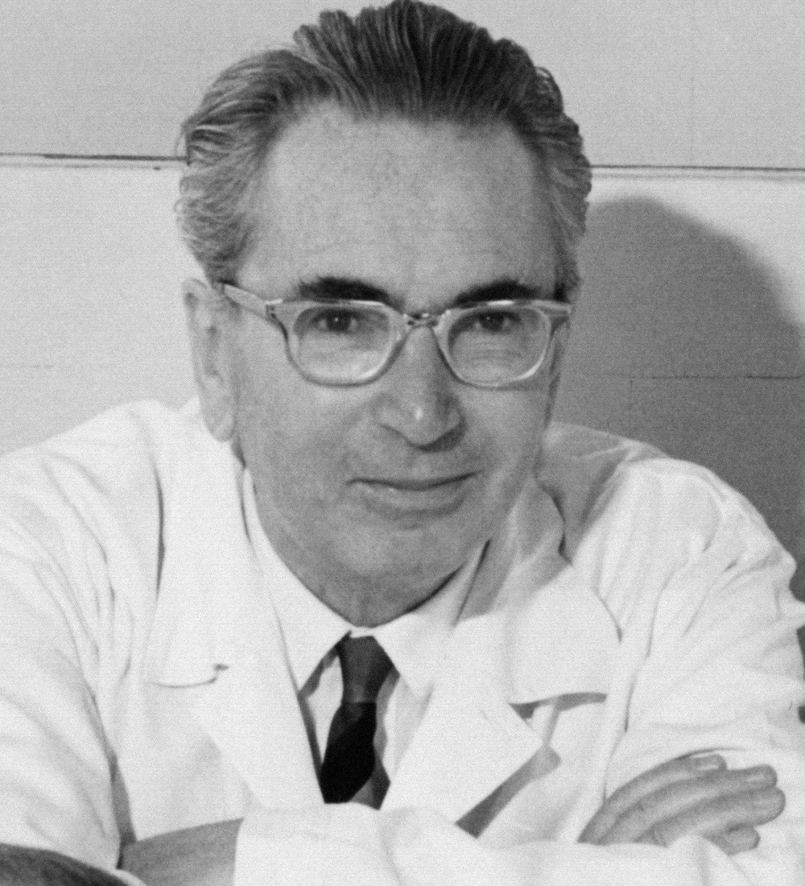
Research Assessment: Success vs. Moral Purpose
“Don’t aim at success […] for success, like happiness, cannot be pursued; it must ensue, and it only does so as the unintended side-effect of one’s dedication to a cause greater than oneself…”
Viktor Frankl
https://www.ted.com/talks/viktor_frankl_youth_in_search_of_meaning

Slide 4
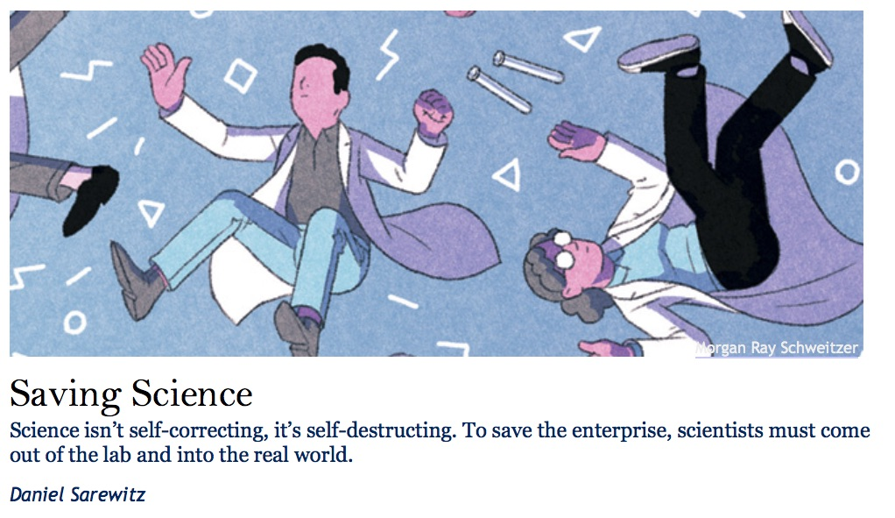
Research Assessment: Curiosity vs. Management
“Advancing according to its own logic, much of science has lost sight of the better world it is supposed to help create. […] The tragic irony here is the the stunted imagination of mainstream science is a consequence of the very autonomy that scientists insist in the key to their success…”
Sarewitz’s article and responses – https://www.thenewatlantis.com/publications/must-science-be-useful

Slide 5
Research Assessment: Curiosity vs. Management
“In the future, the most valuable science institutions will be closely linked to the people and places whose urgent problems need to be solved; they will cultivate strong lines of accountability to those for who solutions are important; they will incentivise scientists to care about the problems more than the production of knowledge. They will link research agendas to the quest for improved solutions – often technological ones – rather than understanding for its own sake. The science they produce will be of higher quality, because it will have to be.”
Sarewitz’s article and responses – https://www.thenewatlantis.com/publications/must-science-be-useful

Slide 6

Principles and practice: questions to keep in mind
How best to work with academics to articulate shared values and co-create feasible systems of evaluation?
  Are we listening? Do we support the needs and aspirations of academics?
  Do academics see how the incentive system has gone wrong? And how that undermines our duties to society?
  Who else should we be working with – outside the academy?
First mover problem: What alliances can we build to reform research evaluation?

Slide 7
Courage, mes amis!
“I wish I’d had the courage to live a life true to myself, not the life others expected of me.”
From ‘The top five regrets of the dying’ by Bronnie Ware (2012)
7

Slide 8


Thank you
s.curry@imperial.ac.uk
@Stephen_Curry
8

Slide 10
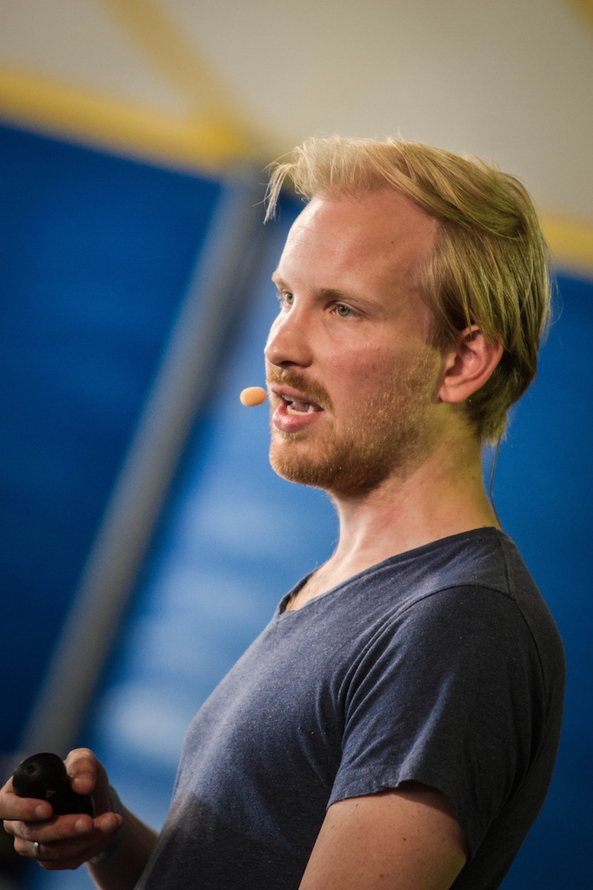
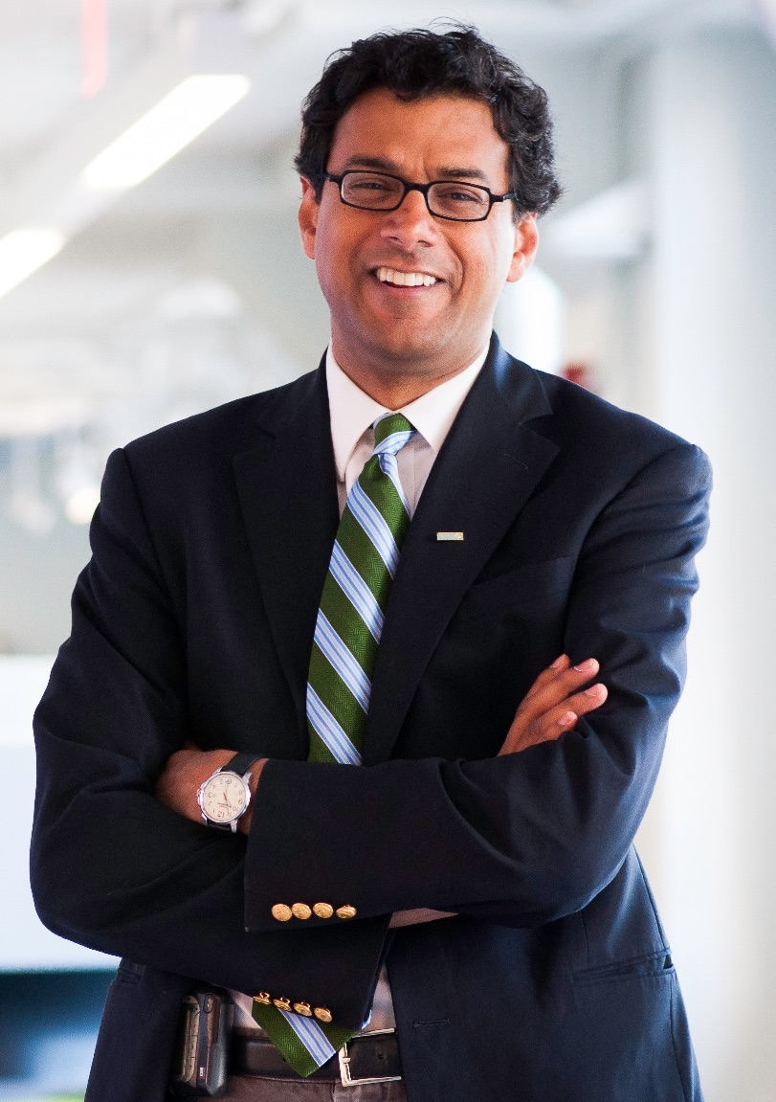
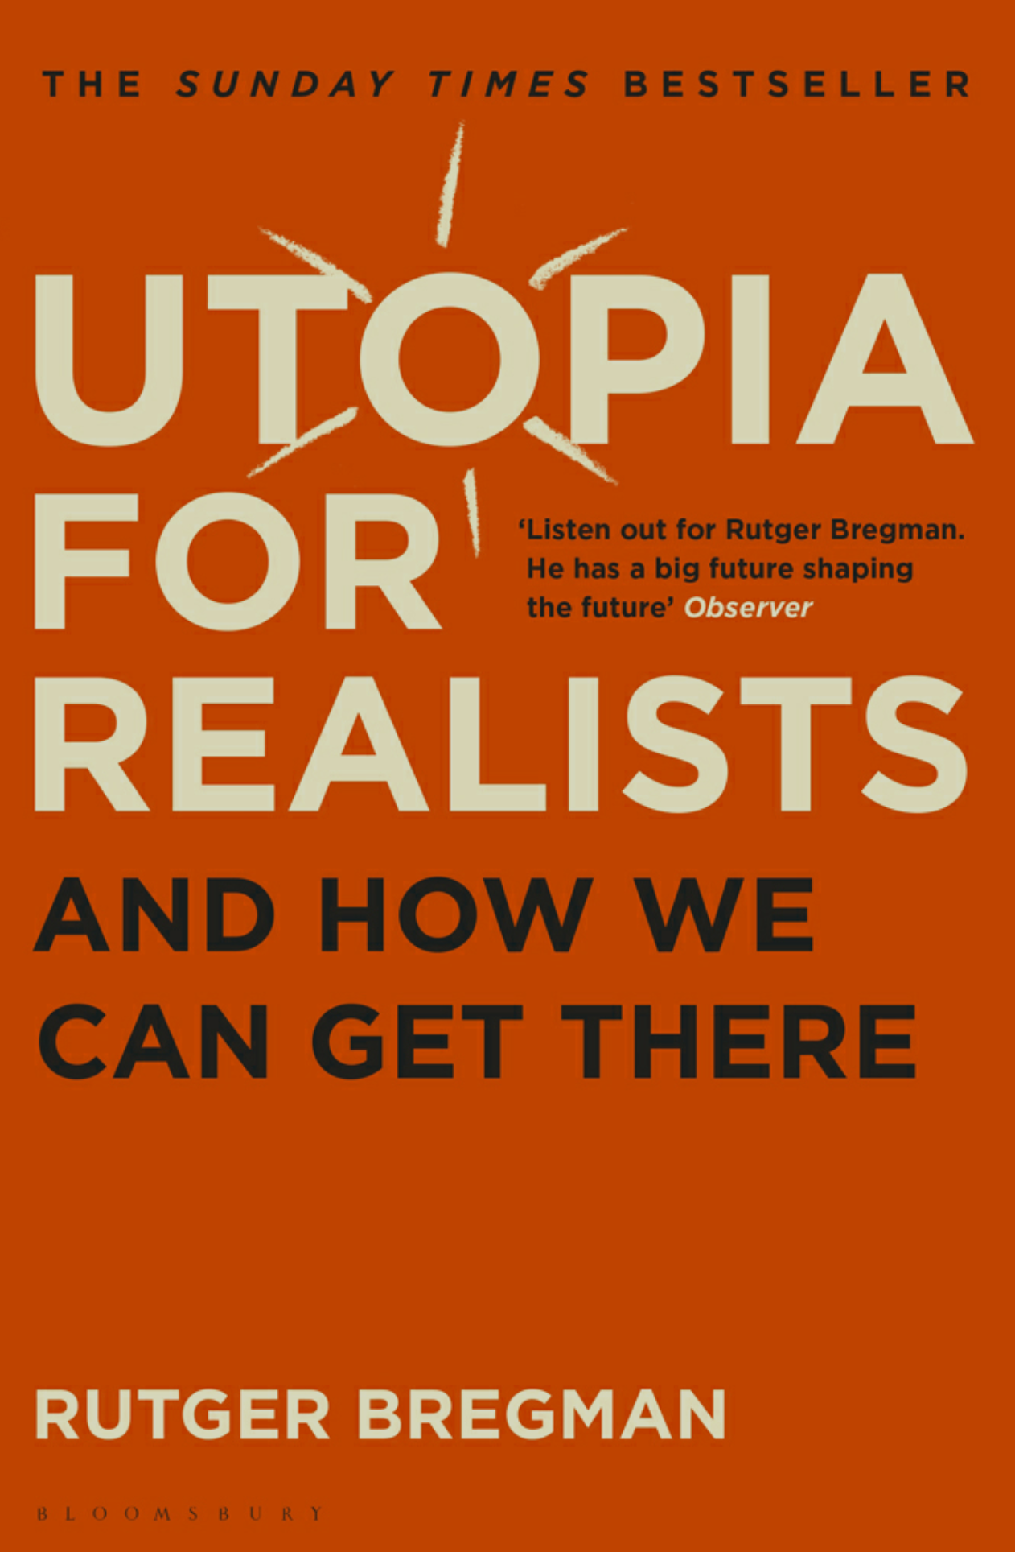
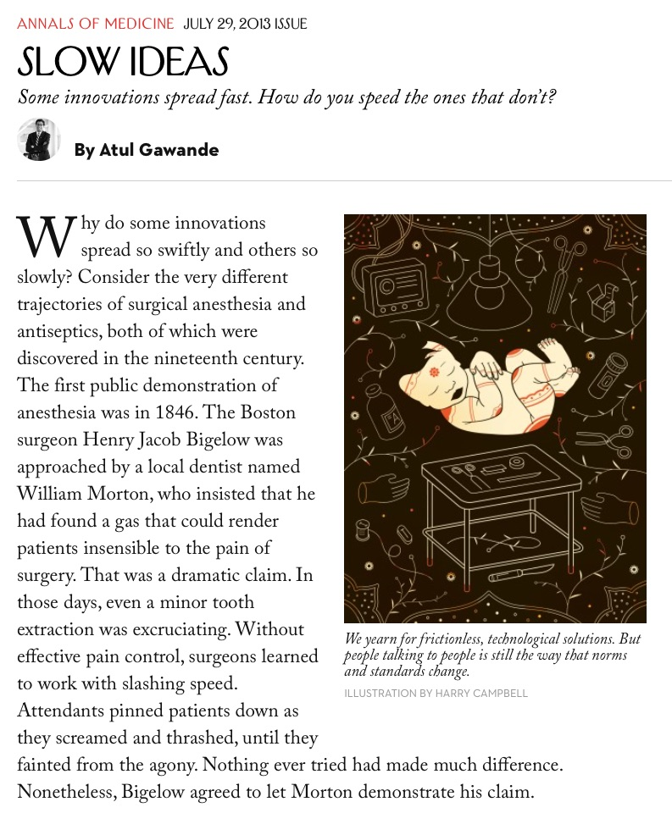
How do we get to our utopia?
http://www.newyorker.com/magazine/2013/07/29/slow-ideas
“If we want to change the world, we need to be unrealistic, unreasonable, and impossible.”
          Rutger Bregman
          “We yearn for frictionless, technological solutions. But people talking to people is still how the world’s standards change.”
          Atul Gawande

Slide 11
Research Assessment: curiosity vs. management
“tenure decisions focus on how many research dollars you bring in, how many articles you get published, and how often those articles are cited…”
“academic science has become an onanistic enterprise worthy of Swift of Kafka…”
“Advancing according to its own logic, much of science has lost sight of the better world it is supposed to help create. […] The tragic irony here is the the stunted imagination of mainstream science is a consequence of the very autonomy that scientists insist in the key to their success…”
Sarewitz’s article and responses – https://www.thenewatlantis.com/publications/must-science-be-useful

