Slide 1
How Can We Change Evaluation of Early Career Scientists?
Paula Stephan
Georgia State University and NBER
October 2019

Slide 2
Six Facts
Large and growing number of PhDs are produced in the biomedical sciences in the US annually: 8500 in 2017, up from 7200 in 2007
Large percent do not have definite commitments at the time they graduate
Largest percent with definite commitments take postdoctoral positions upon graduating
Large percent of postdocs aspire to tenure-track jobs in academe
Very small percent will actually obtain tenure-track jobs
Bibliometrics play a large role along the way

Slide 3
Six Facts
Large and growing number of PhDs are produced in the biomedical sciences in the US annually: 8500 in 2017, up from 7200 in 2007
Large percent do not have definite commitments at the time they graduate
Largest percent with definite commitments take postdoctoral positions upon graduating
Large percent of postdocs aspire to tenure-track jobs in academe
Very small percent will actually obtain tenure-track jobs
Bibliometrics play a large role along the way

Slide 4
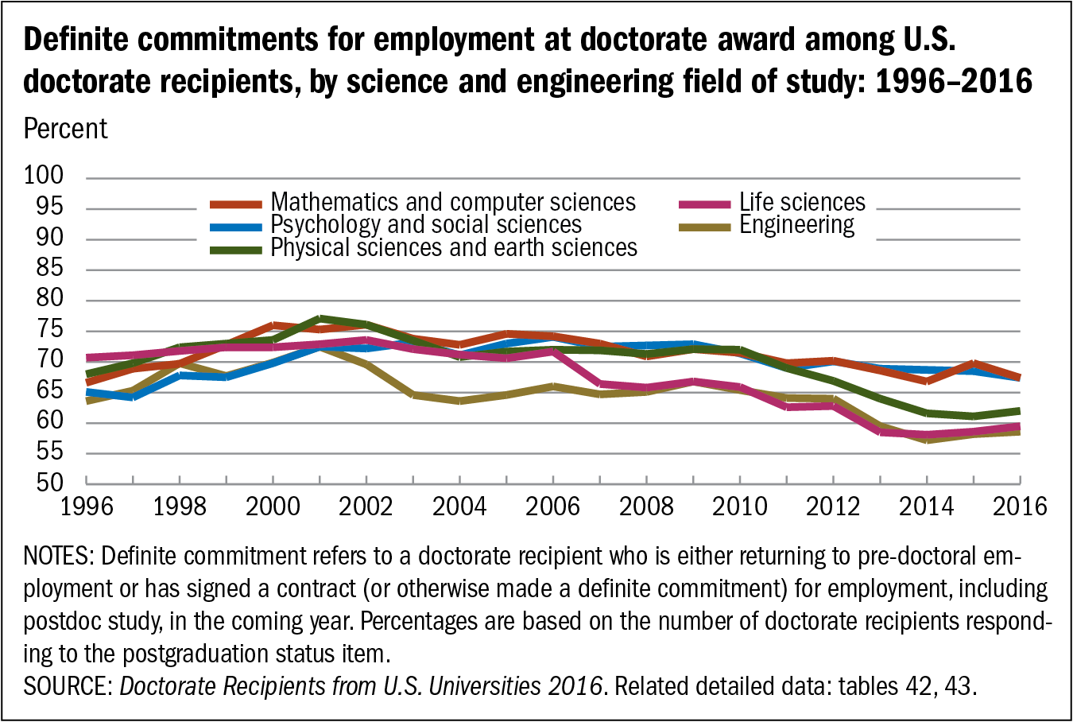

Slide 5
Facts
Large and growing number of PhDs are produced in the biomedical sciences in the US annually: 8500 in 2017, up from 7200 in 2007
Large percent do not have definite commitments at the time they graduate
Largest percent with definite commitments take postdoctoral positions upon graduating
Large percent of postdocs aspire to tenure-track jobs in academe
Very small percent will actually obtain tenure-track jobs
Bibliometrics play a large role along the way

Slide 6
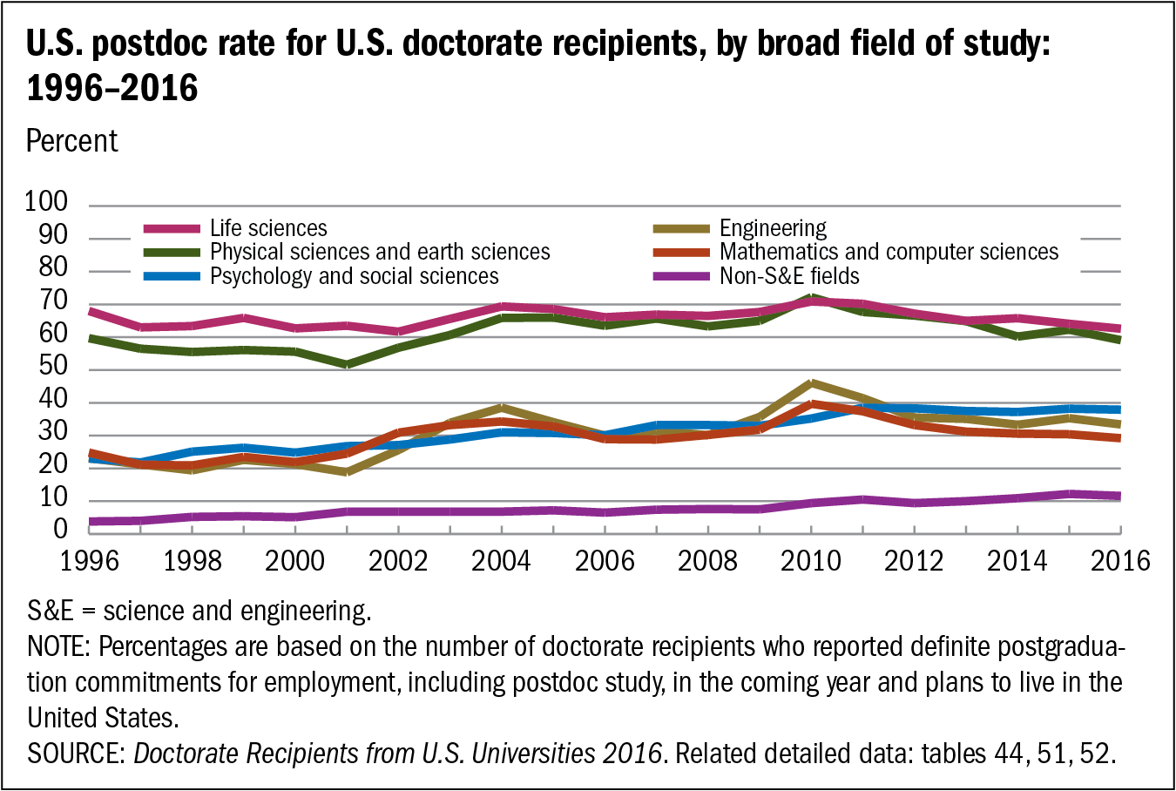

Slide 7
Facts
Large and growing number of PhDs are produced in the biomedical sciences in the US annually: 8500 in 2017, up from 7200 in 2007
Large percent do not have definite commitments at the time they graduate
Largest percent with definite commitments take postdoctoral positions upon graduating
Large percent of postdocs aspire to tenure-track jobs in academe
Very small percent will actually obtain tenure-track jobs
Bibliometrics play a large role along the way

Slide 8
Majority of Postdocs Have Preference for Job in Academe
Sauermann & Roach: “Why Pursue a Postdoc?”

Slide 9
Facts
Large and growing number of PhDs are produced in the biomedical sciences in the US annually: 8500 in 2017, up from 7200 in 2007
Large percent do not have definite commitments at the time they graduate
Largest percent with definite commitments take postdoctoral positions upon graduating
Large percent of postdocs aspire to tenure-track jobs in academe
Very small percent will actually obtain tenure-track jobs
Bibliometrics play a large role along the way

Slide 10
Tenure and Tenure-track Positions
3-5 Years Since PhD
10.6% biological, agricultural and environmental sciences; (17.3%)
14.3% physical sciences; (18.8%)
14.6% engineering; (22.7%)
13.8% computer and information sciences; (55.7%)
29.6% math and statistics; (54.9%)
Red is 2013; Blue is 1993; Table 3-16 Indicators.

Slide 11
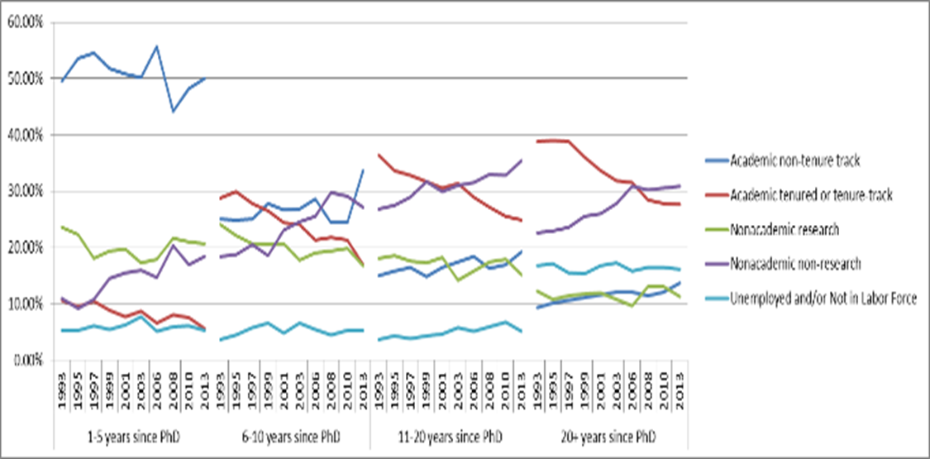
Increase in Non-research, Non-academic Positions; Decline in Tenure-Track Positions

Slide 12
Facts
Large and growing number of PhDs are produced in the biomedical sciences in the US annually: 8500 in 2017, up from 7200 in 2007
Large percent do not have definite commitments at the time they graduate
Largest percent with definite commitments take postdoctoral positions upon graduating
Large percent of postdocs aspire to tenure-track jobs in academe
Very small percent will actually obtain tenure-track jobs
Bibliometrics play a large role along the way

Slide 13

Role of Publications in Top Journals
Publications—especially first authored articles in high impact journals-- are seen as a necessary
condition for getting out of postdoc jail
into an academe position

Slide 14
More Generally
Bibliometrics—especially short term bibliometrics--play large role in
Hiring
Third year review
Evaluation of grants
Promotion

Slide 15
Short Term Bibliometrics and Risk Aversion
Heavy reliance on short-term bibliometric measures arguably encourage risk aversion when it comes to funding individuals as well as hiring and promoting people who take risk
Can be seen in work we did on novelty

Slide 16
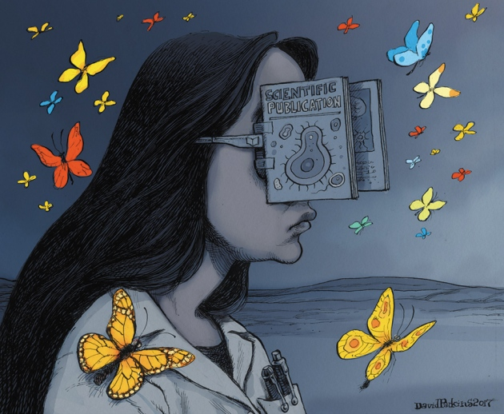
Blinkered by Bibliometrics
Comment in Nature with coauthors explores concern of how bibliometrics reinforce risk aversion and affects early-career researchers
  Jian Wang
  Reinhilde Veugelers
Nature Comment, April 26, 2017

Slide 17
Premise
Novel research that combines streams of knowledge never combined before is risky; more likely to be frontier shifting; also more likely to fail
Operationalize it by looking at number of first ever journal pairs in references of papers published in 2001
Find novel research is rare—11%; highly novel, much, much rarer
Novel research has a higher citation mean and higher variance
More likely to be top cited but also more likely to “fail” in terms of receiving few citations

Slide 18
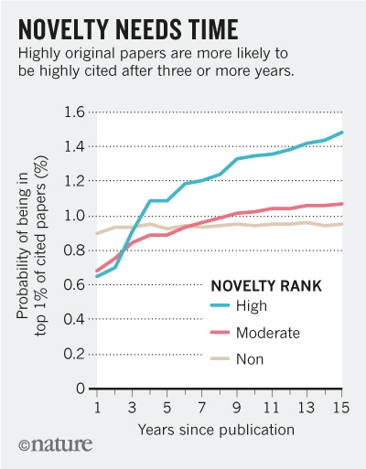
Findings

Slide 19
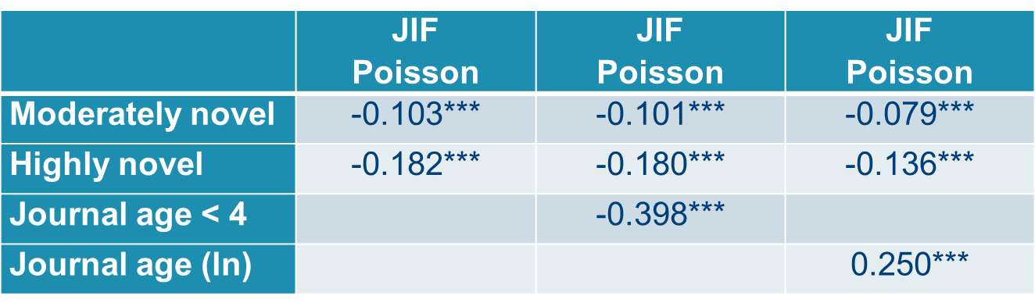
Less Likely to be Published in High Impact Journals

Slide 20
Implication
Heavy reliance on short term bibliometric measures (such as Impact Factors) and recent citations biases decisions against investigators doing novel research
Yet some funding agencies require such bibliometrics be reported in the grant; some encourage it but do not require it
Hiring committees look at such metrics; deans and provosts look at such metrics in third-year review and promotion
AI encourages the use of such metrics

Slide 21
Extend Research by Examining Relationship of Novelty to Receiving an ERC Grant
Know all recipients and sample of applicants who did not receive a grant
Distinguish between those who have done novel research in the past vs those who have not
Find those without a history of novel research are more likely to be funded than those with a history of novel research, holding other things constant
Result is for early career program

Slide 22
What Can (Should) Be Done?

Slide 23
Most Importantly
Stabilize the biomedical workforce
PhD programs and postdoctoral programs are used as inexpensive ways to get the research done;
  Creates unreasonable amount of competition for a limited number of research positions that are allocated on bibliometric measures
There are other ways to get the research done
  Time to create increased number of staff scientists positions and quit growing the supply of PhDs for research positions that are unlikely to materialize

Slide 24
What Can Be Done at Universities?
Need to dedicate more resources to evaluation by READING not COUNTING
Educate deans and provosts to downside of bibliometrics—especially short term bibliometrics
Require applicants for positions and promotion to submit packet of their best—not everything
Stress research portfolio as important criteria; not metrics of accomplishments

Slide 25

More Generally
Create journals for failed research
Deescalate the arms race—rankings are absolutely killing the research enterprise!
Overreliance on university model as host for research; consider moving some research to institutes not affiliated with universities
Consider different funding models
  Lottery? We are spending huge amounts of time writing and evaluating proposals (Carl Bergstrom)

Slide 26
Generate Good, Reliable Placement Data
Undergraduates need to know career prospects before going to graduate school
Some progress is being made here
Under leadership of Ron Daniels, President of Johns Hopkins, Chair Next Generation NAS Committee

Slide 27
Coalition for Next Generation of Life Scientists
Formed while NAS Next Generation committee was meeting
Brings together 37 institutions with a commitment to make career data available
Coalition
Data already available for some institutions UCSF

Slide 28
Thank you!
Questions/Comments
pstephan@gsu.edu

